Slide 1


Python Numpy/Pandas Libraries Machine Learning
Artificial Intelligence Training
Created by Andrew Ferlitsch Instructor July, 2017

Slide 2
Libraries - Numpy
A popular math library in Python for Machine Learning
is ‘numpy’.
Keyword to import a library
Keyword to refer to library by an alias (shortcut) name
import numpy as np
Numpy.org : NumPy is the fundamental package for scientific computing with Python.
a powerful N-dimensional array object
sophisticated (broadcasting) functions
tools for integrating C/C++ and Fortran code
useful linear algebra, Fourier transform, and random number capabilities

Slide 3
Libraries - Numpy
http://www.physics.nyu.edu/pine/pymanual/html/chap3/chap3_arrays.html
The most import data structure for scientific computing in Python is the NumPy array. NumPy arrays are used to store lists of numerical data and to represent vectors, matrices, and even tensors. NumPy arrays are designed to handle large data sets efficiently and with a minimum of fuss. The NumPy library has a large set of routines for creating, manipulating, and transforming NumPy arrays.
Core Python has an array data structure, but it’s not nearly as versatile, efficient, or useful as the NumPy array.

Slide 4
Numpy – Multidimensional Arrays
Numpy’s main object is a multi-dimensional array.
Creating a Numpy Array as a Vector:
Numpy function to create a numpy array
Value is: array( [ 1, 2, 3 ] )
Python list
data = np.array( [ 1, 2, 3 ] )
Creating a Numpy Array as a Matrix:
Outer Dimension
Inner Dimension (rows)
data = np.array( [ [ 1, 2, 3 ], [ 4, 5, 6 ], [ 7, 8, 9 ] ] )
Value is: array( [ 1, 2, 3 ],
[ 4, 5, 6 ],
[ 7, 8, 9 ] )

Slide 5
Numpy – Multidimensional Arrays (2)
Create array with range of values:
Numpy function to create a numpy array with range of values.
Start (inclusive)
data = np.arange( 0, 10 )
End (exclusive)
Value is: array( [ 0, 1, 2, 3, 4, 5, 6, 7, 8, 9 ] )
Reshape an array:
Numpy function to reshape an array (from left to right)
Tuple (rows, columns)
data = data.reshape( ( 2, 5 ) )
Value is: array( [ 0, 1, 2, 3, 4 ],
[ 5, 6, 7, 8, 9 ] )

Slide 6
Numpy – Multidimensional Arrays (3)
Creating an array of Zeros:
Numpy function to create an array of zeros
Value is: array( [ 0, 0, 0 ],
[ 0, 0, 0 ] )
data type (default is float)
data = np.zeros( ( 2, 3 ), dtype=np.int )
rows
columns
Creating an array of Ones:
Value is: array( [ 1, 1, 1 ],
[ 1, 1, 1 ] )
Numpy function to create an array of ones
data = np.ones( (2, 3), dtype=np.int )
Creating an array of random integers:
Upper bound (exclusive)
Lower bound (inclusive)
Number of elements
data = np.random.randint( low, high nelems )

Slide 7
Numpy – Multidimensional Arrays (4)
Min, Max, Mean, Index
data = np.arange( 1, 11 )
Value is: array( [ 1, 2, 3, 4, 5, 6, 7, 8, 9, 10 ] )
data.max()
Maximum value in array: 10
data.argmax()
Index of maximum value in array: 9
data.min()
Minimum value in array: 1
data.argmin()
Index of minimum value in array: 0
data.mean()
Mean (average) of values in array: 5
And many more functions: …

Slide 8
Numpy – Matrix Indexing
Indexing and Slicing
matrix = np.array( [ [ 1, 2, 3 ], [ 4, 5, 6 ], [ 7, 8, 9 ] ] )
Value is: array( [ 1, 2, 3 ],
[ 4, 5, 6 ],
[ 7, 8, 9 ] )
row
Al rows
Al columns
matrix[ 0, 1 ]
matrix[ :, 1 ]
matrix[ 0, : ]
column
column
column
Value is: 2
Value is: array( [ 2, 5, 8 ] )
Value is: array( [ 1, 2, 3] )
Slice: rows 0 and 1 (not including 2)
matrix[ 0:2, : ]
Value is: array( [ 1, 2 ],
[ 4, 5 ],
[ 7, 8 ] )

Slide 9
Libraries - Pandas
A popular library for importing and managing datasets in Python for Machine Learning is ‘pandas’.
Keyword to import a library
Keyword to refer to library by an alias (shortcut) name
import pandas as pd
Used for:
Data Analysis
Data Manipulation
Data Visualization
PyData.org : high-performance, easy-to-use data structures and data analysis tools for the Python programming language.

Slide 10
Pandas – Indexed Arrays
Pandas are used to build indexed arrays (1D) and matrices (2D),
where columns and rows are labeled (named) and can be accessed
via the labels (names).
Columns (features) index
Row (samples) index
x1 | x2 | x3 | x4
raw data
1 | 2 | 3 | 4
4 | 5 | 6 | 7
8 | 9 | 10 | 11
one
two
three
1 | 2 | 3 | 4
4 | 5 | 6 | 7
8 | 9 | 10 | 11
Panda Indexed Matrix

Slide 11
Pandas – Series and Data Frames
Pandas Indexed Arrays are referred to as Series (1D) and
Data Frames (2D).
Series is a 1D labeled (indexed) array and can hold any data type,
and mix of data types.
Series
Raw data
Column Index Labels
s = pd.Series( data, index=[ ‘x1’, ‘x2’, ‘x3’, ‘x4’ ] )
Data Frame is a 2D labeled (indexed) matrix and can hold any data type, and mix of data types.
Data Frame
Row Index Labels
Column Index Labels
df = pd.DataFrame( data, index=[‘one’, ‘two’], columns=[ ‘x1’, ‘x2’, ‘x3’, ‘x4’ ] )

Slide 12
Pandas – Selecting
Selecting One Column
Selects column labeled x1 for all rows
1
4
8
x1 = df[ ‘x1’ ]
Selecting Multiple Columns
Note: df[‘x1’:’x3’ ] this python syntax does not work!
Selects columns labeled x1 and x3 for all rows
Selects columns labeled x1 through x3 for all rows
1 | 3
4 | 6
8 | 10
1 | 2 | 3
4 | 5 | 6
8 | 9 | 10
x1 = df[ [ ‘x1’, ‘x3’ ] ]
x1 = df.ix[ :, ‘x1’:’x3’ ]
rows (all)
columns
Slicing function

Slide 13
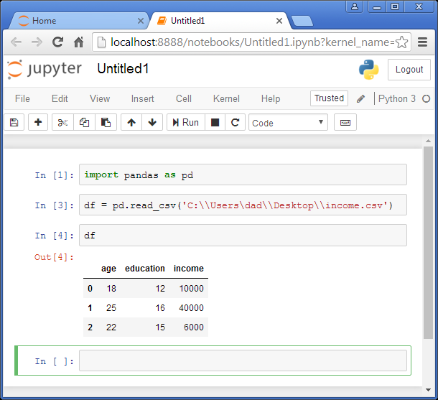
Pandas – Reading in a CSV file
The read_csv() method is used to read a CSV file directly into a data
frame.
Read CSV file into data frame
Display contents of data frame

Slide 14
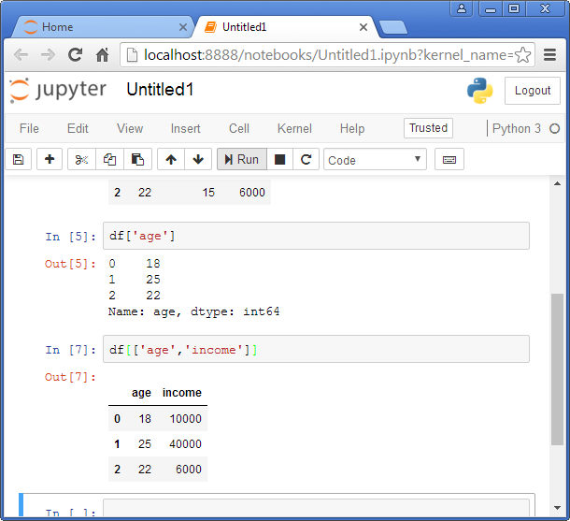
Pandas – Displaying Columns
Display age column using
‘age’ as the index
Display age and income columns
by specifying ‘age’ and ‘income’
as a list.

Slide 15
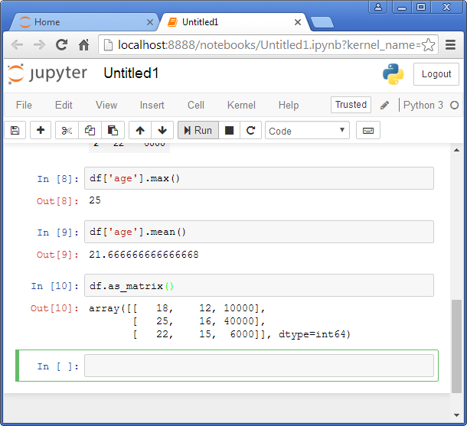
Pandas – Max, Min, Matrix
Display max value of a column.
Display mean value of a column.
Convert data frame to numpy
array (matrix).

Slide 16
Libraries - Matplotlib
A popular library for plotting and visualizing data in Python
Keyword to import a library
Keyword to refer to library by an alias (shortcut) name
import matplotlib.pyplot as plt
Used for:
Plots
Histograms
Bar Charts
Scatter Plots
etc
matplotlib.org: Matplotlib is a Python 2D plotting library which produces publication quality figures in a variety of hardcopy formats and interactive environments across platforms.

Slide 17
Matplotlib - Plot
The function plot plots a 2D graph.
X values to plot
Function to plot
Y values to plot
plt.plot( x, y )
Example:
plt.plot( [ 1, 2, 3 ], [ 4, 6, 8 ] ) # Draws plot in the background
plt.show() # Displays the plot
X
Y
8
6
4
2
1
2
3

Slide 18
Matplotlib – Plot Labels
Add Labels for X and Y Axis and Plot Title (caption)
plt.plot( [ 1, 2, 3 ], [ 4, 6, 8 ] )
plt.xlabel( “X Numbers” ) # Label on the X-axis
plt.ylabel( “Y Numbers” ) # Label on the Y-axis
plt.title( “My Plot of X and Y”) # Title for the Plot
plt.show()
My Plot of X and Y
8
6
Y Numbers
4
2
1
2
3
X Numbers

Slide 19
Matplotlib – Multiple Plots and Legend
You can add multiple plots in a Graph
plt.plot( [ 1, 2, 3 ], [ 4, 6, 8 ], label=‘ 1st Line’ ) # Plot for 1st Line plt.plot( [ 1, 2, 3 ], [ 2, 4, 6 ], label=‘2nd Line’ ) # Plot for 2nd Line
plt.xlabel( “X Numbers” )
plt.ylabel( “Y Numbers” )
plt.title( “My Plot of X and Y”)
plt.legend() # Show Legend for the plots
plt.show()
My Plot of X and Y
8
---- 1st Line
---- 2nd Line
6
Y Numbers
4
2
1
2
3
X Numbers

Slide 20
Matplotlib – Bar Chart
The function bar plots a bar graph.
plt.plot( [ 1, 2, 3 ], [ 4, 6, 8 ] ) # Plot for 1st Line
plt.bar() # Draw a bar chart
plt.show()
8
6
4
2
1
2
3
And many more functions: hist, scatter, …

